Slide 1
7
CHAPTER
OBJECTS AND CLASSES

Slide 2
Chapter Goals
To understand the concept of encapsulation
To master the separation of interface and implementation
To be able to implement and test your own classes
To understand object construction
To categorize relationships between classes
To organize classes into packages
In this chapter, you will learn how to discover, specify, and implement your own classes, and how to use them in your programs.

Slide 3

Contents
Object-Oriented Programming
Specifying the Public Interface of a Class
Instance Variables
Instance Methods
Constructors
Testing a Class
Discovering Classes
Object References
Static Variables and Methods
Packages

Slide 4

7.1 Object-Oriented Programming
You have learned structured programming
Breaking tasks into subtasks
Writing re-usable methods to handle tasks
We will now study Objects and Classes
To build larger and more complex programs
To model objects we use in the world
A class describes objects with the same behavior. For example, a Car class describes all passenger vehicles that have a certain capacity and shape.

Slide 5
Objects and Classes
Classes come first
You design classes to describe a set of objects with the same behavior
Objects are created based on classes
You use the new operator to construct objects
You have used the new operator before:
Scanner in = new Scanner(System.in);
String []names = new String[10]
Class
object
Class
object
Scanner in = new..
String []names = new ..
Use the new operator to construct objects of a class.

Slide 6
7.2 Public Interface of a Class
When you design a class, start by specifying the public interface of the new class
Example: A Cash Register Class
What tasks will this class perform?
What methods will you need?
What parameters will the methods need to receive?
What will the methods return?
Task | Method | Returns
Add the price of an item | addItem(double) | void
Get the total amount owed | getTotal() | double
Get the count of items purchased | getCount() | int
Clear the cash register for a new sale | clear() | void

Slide 7
Writing the Public Interface
/**
A simulated cash register that tracks the item count
and the total amount due.
*/
public class CashRegister
{
/**
Adds an item to this cash register.
@param price: the price of this item
*/
public void addItem(double price)
{
// Method body
}
/**
Gets the price of all items in the current sale.
@return the total price
*/
public double getTotal() ...
The method declarations make up the public interface of the class
The data and method bodies make up the private implementation of the class

Slide 8
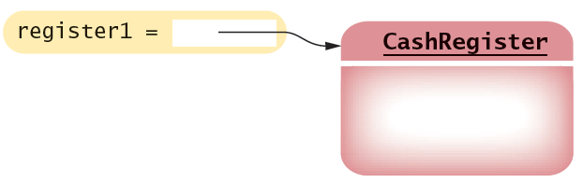
Non-static methods means…
We have been writing class methods using the static modifier:
For non-static (instance) methods, you must instantiate an object of the class before you can invoke methods
Then invoke methods of the object
public static void addItem(double val)
public void addItem(double val)
public static void main(String[] args)
{
// Construct a CashRegister object
CashRegister register1 = new CashRegister();
// Invoke a non-static method of the object
register1.addItem(1.95);
}

Slide 9
Accessor and Mutator Methods
Many methods fall into two categories:
1) Accessor Methods: ‘get’ methods
Asks the object for information without changing it
Normally return a value of some type
2) Mutator Methods: ‘set’ methods
Changes values in the object
Usually take a parameter that will change an instance variable
Normally return void
public double getTotal() { }
public int getCount() { }
public void addItem(double price) { }
public void clear() { }

Slide 10
7.3 Instance Variables
An object stores data in instance variables
Variables declared inside the class
All methods inside the class have access to them
Can change or access them
What data will our CashRegister methods need?
Task | Method | Data Needed
Add the price of an item | addItem() | total, count
Get the total amount owed | getTotal() | total
Get the count of items purchased | getCount() | count
Clear the cash register for a new sale | clear() | total, count
An object holds instance variables that are accessed by methods

Slide 11
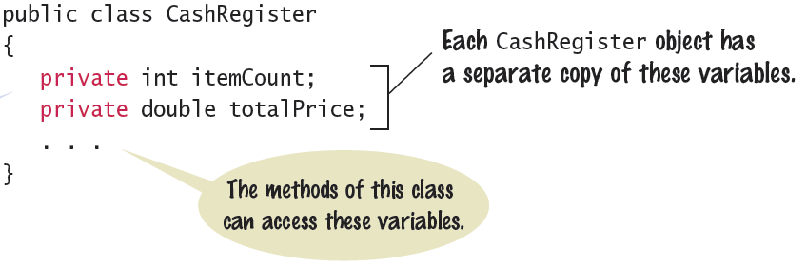
Syntax 7.1: Instance Variables
Declare instance variables at the beginning of the class:
They should be declared as private data members
The alternative (public) would give other classes direct access
Each instance variable is declared just like other variables we have used.

Slide 12

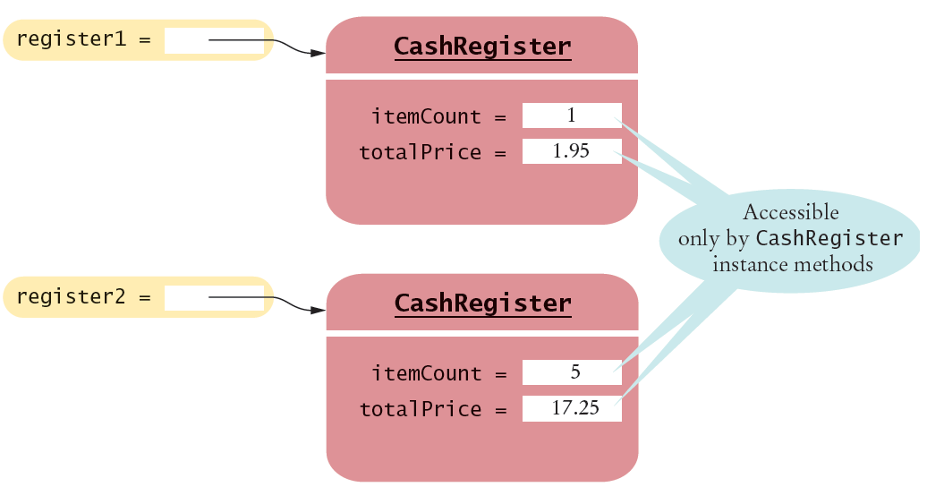
Instance Variables of Objects
Each object of a class has a separate set of instance variables.
The values stored in instance variables make up the state of the object.

Slide 13
Accessing Instance Variables
private instance variables cannot be accessed from methods outside of the class
public static void main(String[] args)
{
. . .
System.out.println(register1.itemCount); // Error
. . .
}
The compiler will not allow this violation of privacy
Use accessor methods of the class instead!
public static void main(String[] args)
{
. . .
System.out.println( register1.getCount() ); // OK
. . .
}
Encapsulation provides a public interface and hides the implementation details.

Slide 14
7.4 Instance Methods
Implement instance methods that will use the private instance variables
public void addItem(double price)
{
itemCount++;
totalPrice = totalPrice + price;
}
Task | Method | Returns
Add the price of an item | addItem(double) | void
Get the total amount owed | getTotal() | double
Get the count of items purchased | getCount() | int
Clear the cash register for a new sale | clear() | void

Slide 15
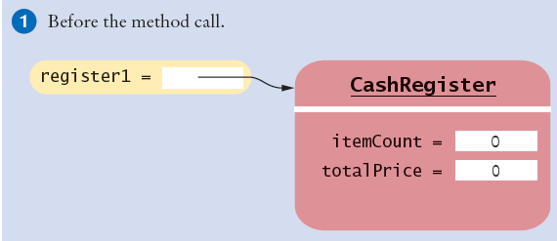
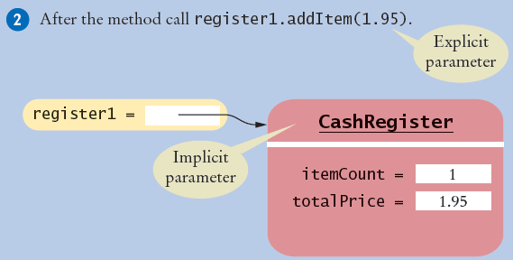
Implicit and Explicit Parameters
When an item is added, it affects the instance variables of the object on which the method is invoked
The object on which a method is applied is the implicit parameter

Slide 16
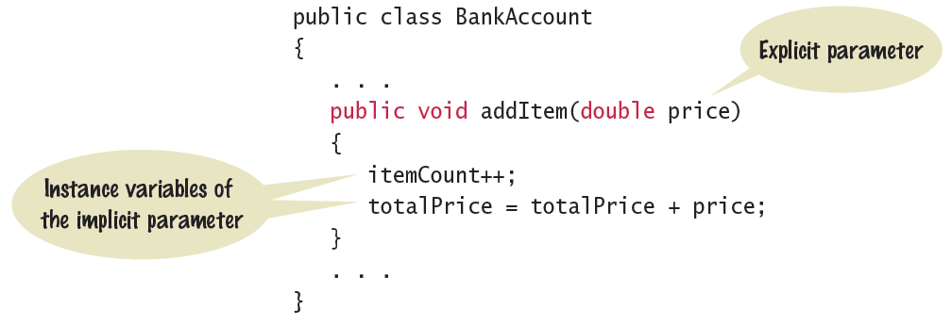
Syntax 7.2: Instance Methods
Use instance variables inside methods of the class
There is no need to specify the implicit parameter when using instance variables inside the class
Explicit parameters must be listed in the method declaration

Slide 17
7.5 Constructors
A constructor is a method that initializes instance variables of an object
It is automatically called when an object is created
It has exactly the same name as the class
public class CashRegister
{
. . .
/**
Constructs a cash register with cleared item count and total.
*/
public CashRegister() // A constructor
{
itemCount = 0;
totalPrice = 0;
}
}
Constructors never return values, but do not use void in their declaration

Slide 18
Multiple Constructors
A class can have more than one constructor
Each must have a unique set of parameters
public class BankAccount
{
. . .
/**
Constructs a bank account with a zero balance.
*/
public BankAccount( ) { . . . }
/**
Constructs a bank account with a given balance.
@param initialBalance the initial balance
*/
public BankAccount(double initialBalance) { . . . }
}
The compiler picks the constructor that matches the construction parameters.
BankAccount joesAccount = new BankAccount();
BankAccount lisasAccount = new BankAccount(499.95);

Slide 19
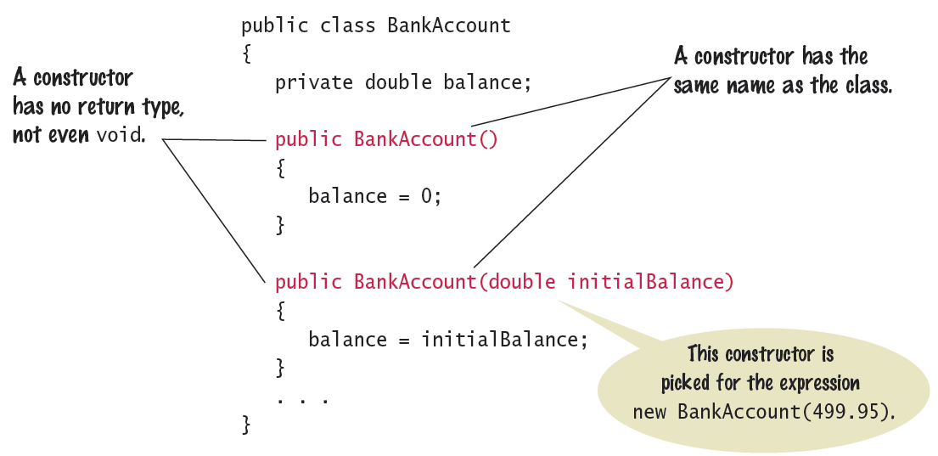
Syntax 7.3: Constructor
One constructors is invoked when the object is created with the new keyword

Slide 20
The Default Constructor
If you do not supply any constructors, the compiler will make a default constructor automatically
It has no parameters
It initializes all instance variables
public class CashRegister
{
. . .
/**
Does exactly what a compiler generated constructor would do.
*/
public CashRegister()
{
itemCount = 0;
totalPrice = 0;
}
}
By default, numbers are initialized to 0, booleans to false, and objects as null.

Slide 21
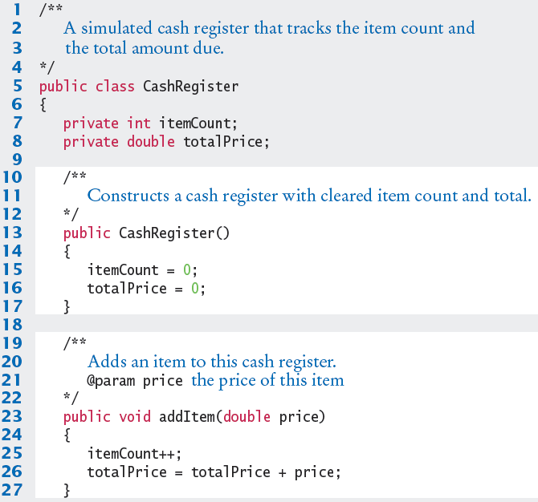
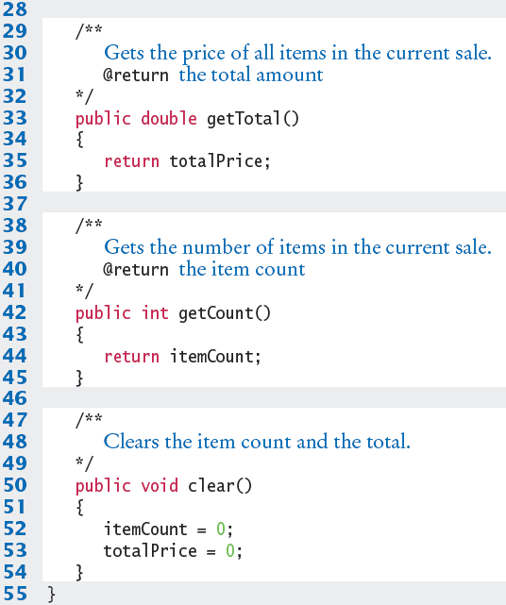
CashRegister.java

Slide 22

Common Error 7.1
Not initializing object references in constructor
References are by default initialized to null
Calling a method on a null reference results in a runtime error: NullPointerException
The compiler catches uninitialized local variables for you
public class BankAccount
{
private String name; // default constructor will set to null
public void showStrings()
{
String localName;
System.out.println(name.length());
System.out.println(localName.length());
}
}
Runtime Error: java.lang.NullPointerException
Compiler Error: variable localName might not have been initialized

Slide 23
Common Error 7.2
Trying to Call a Constructor
You cannot call a constructor like other methods
It is ‘invoked’ for you by the new keyword
You cannot invoke the constructor on an existing object:
But you can create a new object using your existing reference
CashRegister register1 = new CashRegister();
register1.CashRegister(); // Error
CashRegister register1 = new CashRegister();
Register1.newItem(1.95);
CashRegister register1 = new CashRegister();

Slide 24
Common Error 7.3
Declaring a Constructor as void
Constructors have no return type
This creates a method with a return type of void which is NOT a constructor!
The Java compiler does not consider this an error
public class BankAccount
{
/**
Intended to be a constructor.
*/
public void BankAccount( )
{
. . .
}
}
Not a constructor…. Just another method that returns nothing (void)

Slide 25

Special Topic 7.1
Overloading
We have seen that multiple constructors can have exactly the same name
They require different lists of parameters
Actually any method can be overloaded
Same method name with different parameters
We will not be using overloading in this book
Except as required for constructors
void print(CashRegister register) { . . . }
void print(BankAccount account) { . . . }
void print(int value) { . . . }
Void print(double value) { . . . }

Slide 26
7.6 Testing a Class
We wrote a CashRegister class but…
You cannot execute the class – it has no main method
It can become part of a larger program
Test it first though with unit testing
To test a new class, you can use:
Programming tools that interactively create objects:
DrJava: www.drjava.org
BlueJ: www.bluej.org
Write a tester class:
With a main
public class CashRegisterTester
{
public static void main(String[] args)
{
CashRegister c1 = new CashRegister();
...

Slide 27
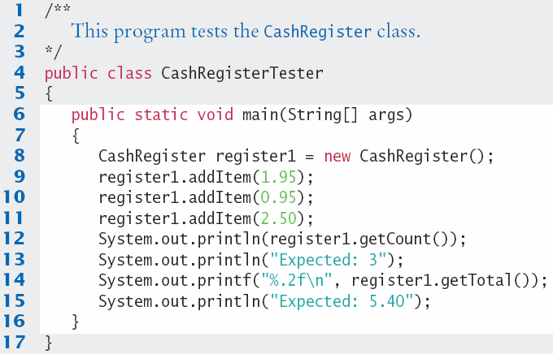
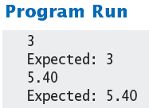
CashRegisterTester.java
Test all methods
Print expected results
Output actual results
Compare results
A unit test verifies that a class works correctly in isolation, outside a complete program.

Slide 28

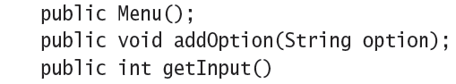
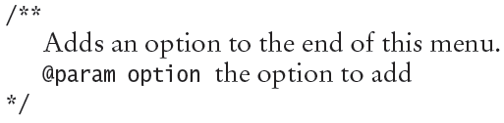
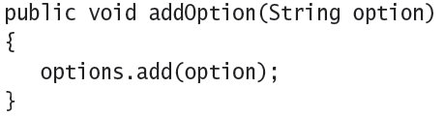
Steps to Implementing a Class
1) Get an informal list of responsibilities for your objects
2) Specify the public interface
3) Document the public interface
Javadoc comments
4) Determine the instance variables
5) Implement constructors and methods
6) Test your class

Slide 29
7.7 Discovering Classes
Designing an object-oriented program is different than designing a ‘structured’ program.
Both can be used to solve a problem
First, decide what classes to use
Classes you create yourself
Reuse existing classes
Carefully examine the problem description to find what classes you may need:
Look for nouns
May also be concepts
CannonBall
CashRegister
Monster
BankAccount
Owner

Slide 30
Discovering Classes
One test can be
If you can’t tell from the class name what an object of the class is supposed to do, then you are probably not on the right track.
Example: Write a program to calculate and print paychecks. What class to use?
PayCheckProgram?
What would objects of this class do?
ComputePayCheck?
Can you visualize this as an object?
PayCheck
Better – More general
Methods:
Calculate
Print
Deposit ...

Slide 31
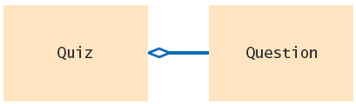
Multiple Classes
Programs often use multiple classes
How do they relate to each other?
Does one class ‘contain’ one of the other classes?
Example: A quiz contains questions
A UML class diagram showing a ‘has-a’ relationship
denotes ‘aggregation’
One fundamental relationships between classes is the “aggregation” relationship (which is informally known as the “has-a” relationship).

Slide 32

A Classy Automobile
To review, consider a car
What objects can you see?
Find the nouns
Car
Engine
Then find verbs associated with teach
Buy the car
Start the engine
And find the relationships
A Car ‘has an’ engine
A Car ‘has’ wheels
Wheels
Tires
Rotate the wheels
Change a tire
A wheel ‘has a’ tire

Slide 33

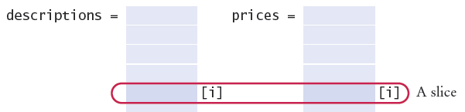
Programming Tip 7.2
Making Parallel Arrays into Arrays of Objects
A parallel array is when you use multiple arrays to store information about the same ‘object’
Example: An invoice contains a list of items, each with a description and a price:
One slice per item
// Parallel Arrays
String[] descriptions;
Double[] prices;

Slide 34

Programming Tip 7.2
Making Parallel Arrays into Arrays of Objects
Convert a ‘slice’ into attributes of an object
Then make an arrays of the objects
public class Item
{
private String description;
private double price;
. . .
}
Item[] items;

Slide 35

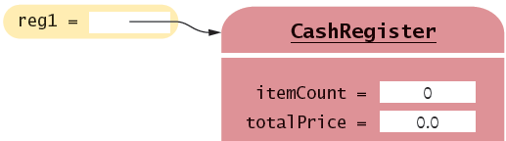
7.8 Object References
Objects are similar to arrays because they always have reference variables
Array Reference
Object Reference
double[] values = new double[5]
CashRegister reg1 = new CashRegister;
An object reference specifies the location of the object

Slide 36
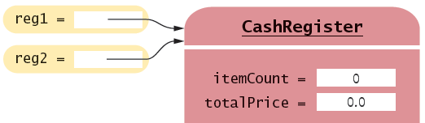
Shared References to an Object
Multiple object variables may contain references to the same object.
Single Reference
Shared References
CashRegister reg1 = new CashRegister;
CashRegister reg2 = reg1;
The internal values can be changed through either reference

Slide 37
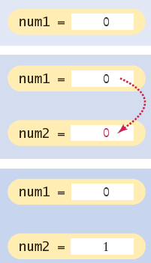
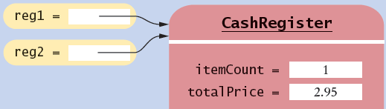
Primitive versus Reference Copy
Primitive variables can be copied, but work differently than object references
Primitive Copy Reference Copy
Two locations One location for both
int num1 = 0;
int num2 = num1;
num2++;
CashRegister reg1 = new CashRegister;
CashRegister reg2 = reg1;
reg2.addItem(2.95);
Why? Primitives take much less storage space than objects!

Slide 38
The null reference
A reference may point to ‘no’ object
You cannot invoke methods of an object via a null reference – causes a runtime error
To test if a reference is null before using it:
CashRegister reg = null;
System.out.println(reg.getTotal()); // Runtime Error!
String middleInitial = null; // No middle initial
if (middleInitial == null)
System.out.println(firstName + " " + lastName);
else
System.out.println(firstName + " " + middleInitial + ". " + lastName);

Slide 39
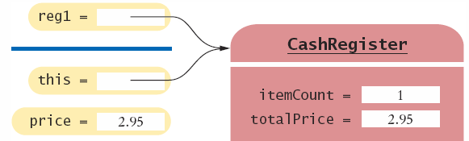
The this reference
Methods receive the ‘implicit parameter’ in a reference variable called ‘this’
It is a reference to the object the method was invoked on:
It can clarify when instance variables are used:
void addItem(double price)
{
this.itemCount++;
this.totalPrice = this.totalPrice + price;
}

Slide 40

7.9 static Variables and Methods
Variables can be declared as static in the Class declaration
There is one copy of a static variable that is shared among all objects of the Class
public class BankAccount
{
private double balance;
private int accountNumber;
private static int lastAssignedNumber = 1000;
public BankAccount()
{
lastAssignedNumber++;
accountNumber = lastAssignedNumber;
}
. . .
}
Methods of any object of the class can use or change the value of a static variable

Slide 41
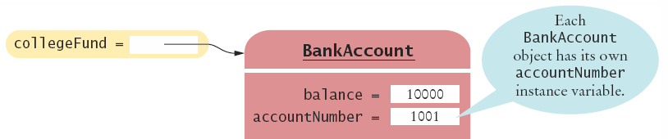
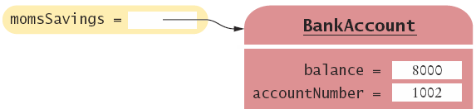
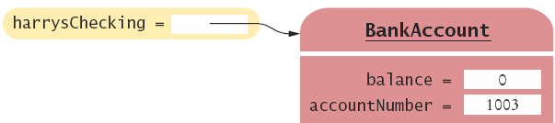
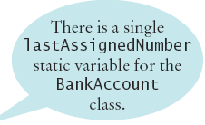
Using static Variables
Example:
Each time a new account is created, the lastAssignedNumber variable is incremented by the constructor
Access the static variable using:
ClassName.variableName

Slide 42
Using static Methods
The Java API has many classes that provide methods you can use without instantiating objects
The Math class is an example we have used
Math.sqrt(value) is a static method that returns the square root of a value
You do not need to instantiate the Math class first
Access static methods using:
ClassName.methodName()

Slide 43
Writing your own static Methods
You can define your own static methods
public class Financial
{
/**
Computes a percentage of an amount.
@param percentage the percentage to apply
@param amount the amount to which the percentage is applied
@return the requested percentage of the amount
*/
public static double percentOf(double percentage, double amount)
{
return (percentage / 100) * amount;
}
}
static methods usually return a value. They can only access static variables and methods.
Invoke the method on the Class, not an object
double tax = Financial.percentOf(taxRate, total);

Slide 44
7.10 Java Packages
Java programs are a collection of classes
As programs become more complex, it is often useful to group sets of classes into ‘packages’
The Java API is structured as a set of packages
You have used packages by using import:
The Scanner class is in the java.util package
import java.util.*; // Enables use of all java.util classes
public String getInput()
{
Scanner keyboard = new Scanner(System.in);
String temp = keyboard.next();
. . .
}

Slide 45
Importing Packages
You can use classes from other packages by:
1) Using their ‘full names’ (java.util.Scanner)
2) Using import first, then using the class name (Scanner)
public String getInput()
{
java.util.Scanner keyboard = new java.util.Scanner(System.in);
. . .
}
import java.util.*; // Enables use of all java.util classes
public String getInput()
{
Scanner keyboard = new Scanner(System.in);
. . .
}

Slide 46
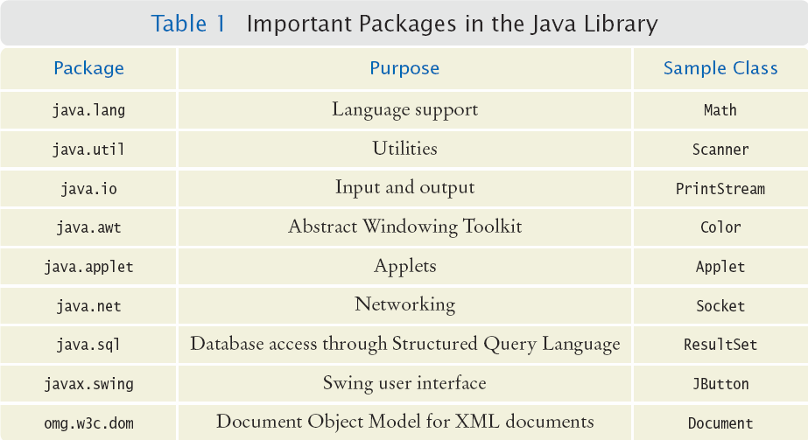
Key Packages in the Java Library

Slide 47
Organizing Classes into Packages
When you find a collection of classes that are closely related
Declare each class with package packageName;
Put the classes in a folder based on packageName
JavaWork
package project1;
public class CashRegister
{
. . .
}
project1
project2
Benefits of Packages
Avoids name clashes
Which do you mean?
project1.CashRegister
project2.CashRegister
package project2;
public class CashRegister
{
. . .
}

Slide 48
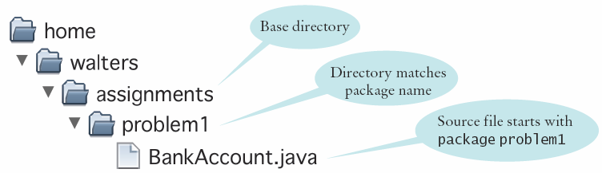
Naming Packages
Java package naming is designed to prevent package name duplication
Based on Internet domain name system (DNS)
package com.mccarthy.javanotes;
\\ Stored in javanotes.mccarthy.com
Use a domain name in reverse to construct an unambiguous package name.

Slide 49
How Local Packages are Located
A package is located in a subdirectory that matches the package name
Classes in package homework1 are located in a folder named homework1
The path of a class file must match its package name.
homework1 is a subdirectory located in a folder named C:\Users\walters\assignments
C:\Users\walters\assignments is the ‘base directory’
If a class in the base directory folder wants to use classes in package (and folder) named homework1:
import homework1.*;

Slide 50
Summary: Classes
A class describes a set of objects with the same behavior.
Use the new operator to construct objects from a class.
Methods that are invoked on objects are called instance methods.
Every class has a public interface: a collection of methods through which the objects of the class can be manipulated.
Encapsulation is the act of providing a public interface and hiding the implementation details.

Slide 51
Summary: Encapsulation
Encapsulation enables changes in the implementation without affecting users of a class.
A mutator method changes the object on which it operates.
An accessor method does not change the object on which it operates, and normally returns a value based on instance variables

Slide 52
Summary: Objects
An object holds instance variables that are accessed by methods.
Every object has its own set of instance variables.
Private instance variables can only be accessed by methods of the same class.
The object on which a method is applied is the implicit parameter.
Explicit parameters of a method are listed in the method declaration.

Slide 53
Summary: Constructors
A constructor initializes the instance variables of an object.
The name of a constructor is the same as the class name.
A class can have multiple constructors.
The compiler picks the constructor that matches the construction parameters.
By default, numbers are initialized as 0, Booleans as false, and objects as null.
If you do not provide a constructor, a constructor with no parameters is generated.

Slide 54
Summary
A unit test verifies that a class works correctly in isolation, outside a complete program.
To test a class, use an environment for interactive testing, or write a tester class to execute test instructions.
Determining the expected result in advance is an important part of testing.
Discovering Classes
To discover classes, look for nouns in the problem description.
Concepts from the problem domain are good candidates for classes.

